Slide 1

DIGITAL
Intoduction to Flexbox Properties
- Rohit Kr Vashishtha & Robin Mehra

Slide 2
Agenda
What is Flexbox
Syntax
Browser Support
The Keys to a Flexbox Layout
Introduction to flexbox properties:
justify-content Property
align-items/align-self Property
align-content Property
flex-direction Property
flex-wrap Property
flex-flow Property
Order
Demos
Exercises

Slide 3
What is flexbox?
Flexbox is Flexible Box Layout Module
It is mainly a flexible container inshort flexbox
CSS floats and clearfix hacks are very much popular to get proper multi-column layouts.
Flexbox is an alternative for this.
In future it can overcome Floats and clearfixs.
It’s great for mobile screens and responsive content for dynamic layouts and webapps.

Slide 4
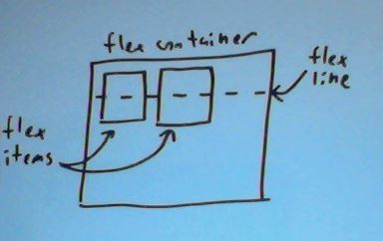
Syntax
HTML:
<div class="flex-container">
<div class="flex-item">flex item 1</div>
<div class="flex-item">flex item 2</div>
</div>
CSS
.flex-container {
display: -webkit-flex;
display: flex;
width: 300px;
height: 240px;
background-color: Silver;
}
.flex-item {
background-color: DeepSkyBlue;
width: 100px;
height: 100px;
}

Slide 5
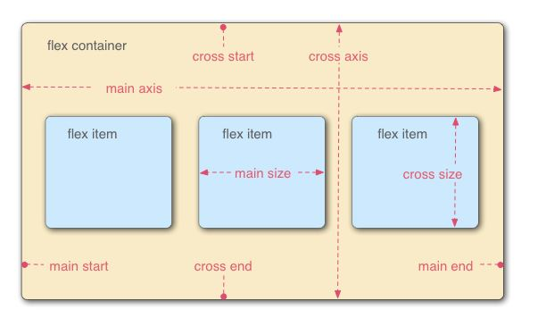
The Keys to a Flexbox Layout
Container: Flex container: display:flex
Children: flex items: items
Axes: Every flexible box layout follows two axes.
The main axis is the axis along which the flex items follow each other.
The cross axis is the axis perpendicular to the main axis.
Direction/Flow of items: flex-direction

Slide 6
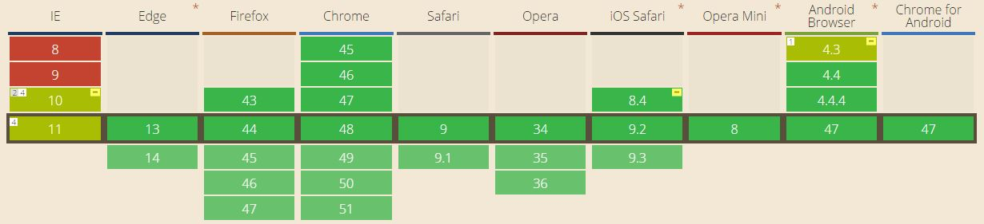
Browser Support
caniuse.com
display:-webkit-box; /*old prefixed for webkit*/
display:-moz-box; /*old prefixed for mozilla*/
display:-ms-flexbox; /*inbetween prefixed for ie*/
display:-webkit-flex; /*new prefixed for webkit*/
display:flex; /*new*/

Slide 7
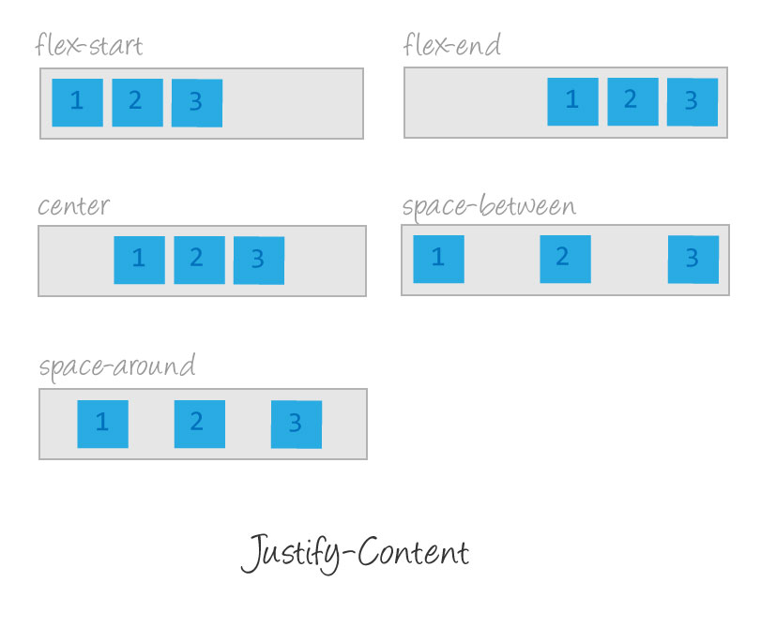
justify-content Property
justify-content: aligns items horizontally, (along the main axis) and accepts the following values:
flex-start: Items align to the left side of the container.
flex-end: Items align to the right side of the container.
center: Items align at the center of the container.
space-between: Items display with equal spacing between them.
space-around: Items display with equal spacing around them.

Slide 8
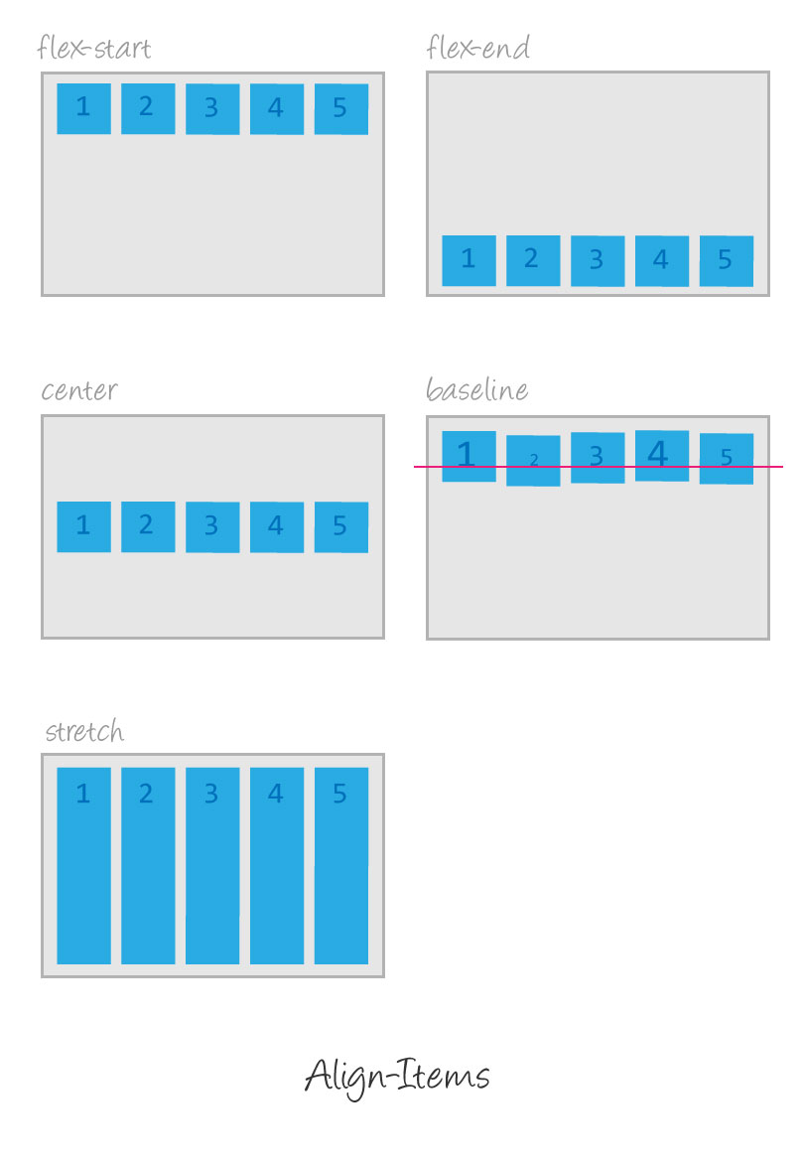
align-items/align-self Property (same)
align-items: aligns items vertically (along the cross axis) and accepts the following values:
flex-start: Items align to the top of the container.
flex-end: Items align to the bottom of the container.
center: Items align at the vertical center of the container.
baseline: Items display at the baseline of the container.
stretch: Items are stretched to fit the container.

Slide 9
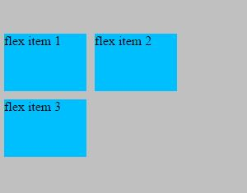
align-content Property
align-content to set how multiple lines are spaced apart from each other. This property takes the following values:
flex-start: Lines are packed at the top of the container.
flex-end: Lines are packed at the bottom of the container.
center: Lines are packed at the vertical center of the container.
space-between: Lines display with equal spacing between them.
space-around: Lines display with equal spacing around them.
Stretch: Lines are stretched to fit the container.
NOTE: When there is only one line, align-content has no effect.

Slide 10
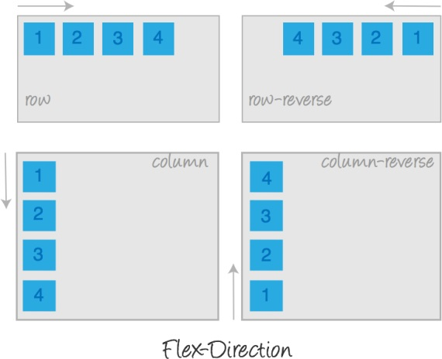
flex-direction Property
flex-direction: defines the direction items are placed in the container, and accepts the following values:
row: Items are placed the same as the text direction.
row-reverse: Items are placed opposite to the text direction.
column: Items are placed top to bottom.
column-reverse: Items are placed bottom to top.

Slide 11
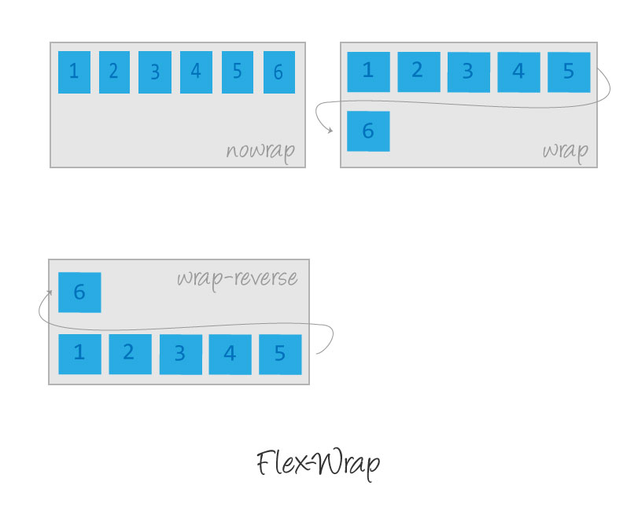
flex-wrap Property
flex-wrap: nowrap | wrap | wrap-reverserow:
Items are placed the same as the text direction.
nowrap: Every item is fit to a single line.
wrap: Items wrap around to additional lines.
wrap-reverse: Items wrap around to additional lines in reverse.

Slide 12
flex-flow Property
The two properties flex-direction and flex-wrap are used so often together that the shorthand property flex-flow was created to combine them. This shorthand property accepts the value of one of the two properties separated by a space.
For example, you can use flex-flow: row wrap to set rows and wrap them.
div { display: flex; flex-flow: row-reverse wrap; }

Slide 13
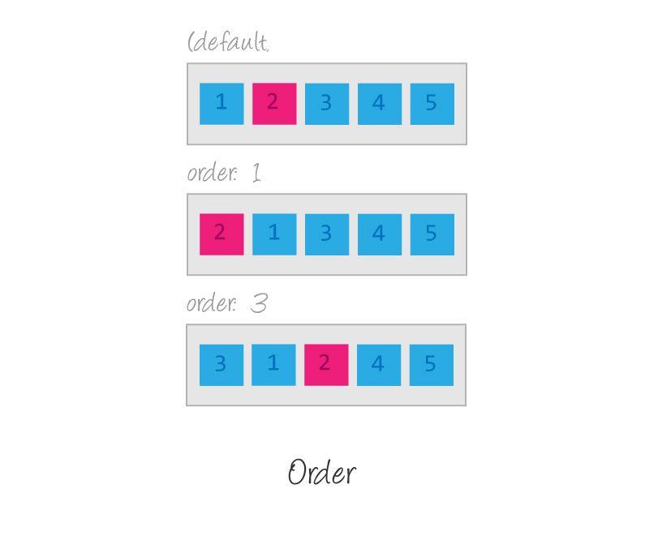
Order
Sometimes reversing the row or column order of a container is not enough. In these cases, we can apply the order property to individual items. By default, items have a value of 0, but we can use this property to set it to a positive or negative integer value.
Order <integer>

Slide 14


Slide 15


